Slide 1


SELLING YOUR HOME
A GUIDE TO

Slide 2
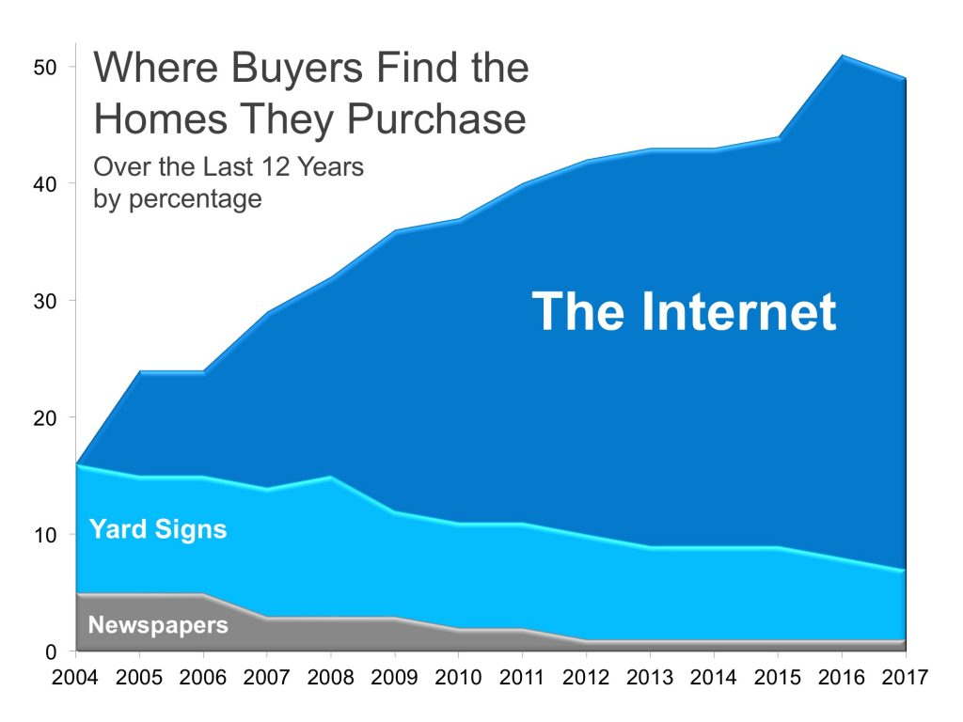

Today’s buyer begins their home search online. Advancements in internet technology now allow us to measure and monitor activity on your home’s listing.

Slide 3


Understanding how buyers search for a home helps us know how to market your home. Bringing you the best price, in the least amount of time, with the least inconvenience to you. you.
Buyers typically searched for 10 weeks and looked at a median of 10 homes
88% of home buyers found information online to be the most useful source of information
87% percent of buyers recently purchased their home through a real estate agent or broker, and 7% purchased directly from a builder or
builder’s agent.
79% percent of recent buyers found their real estate agent to be a very useful information source.

Slide 4


KW Invests Heavily To Stay Ahead
Of The Technology Curve
From cutting edge websites to artificial intelligence, we have the tools to simplify everyday complications and make your real estate transaction smooth and stress-free.

Slide 5


Your property will be syndicated to over 750 websites. Our unique Keller Williams Listing System ( KWLS ) provides enhanced marketing capabilities beyond those offered by the Multiple Listing Service used by other companies.
Social Media postings enhance the syndication of our multiple networking sites. This is just one of the ways Keller Williams can increase the interest and exposure of your home’s listing online.
News feeds have replaced newspapers!

Slide 6



Slide 7
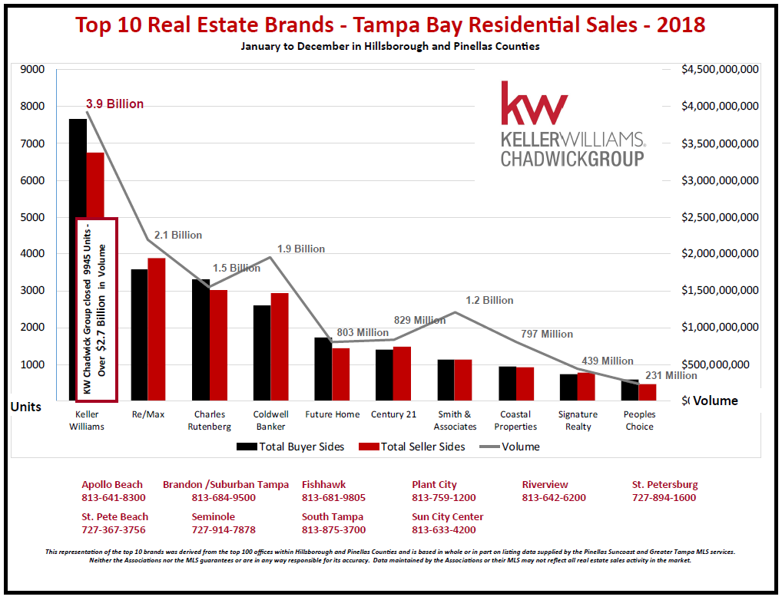



Keller Williams Agents are
Trusted – Recognized – Driven by Results
SOLD

Slide 8
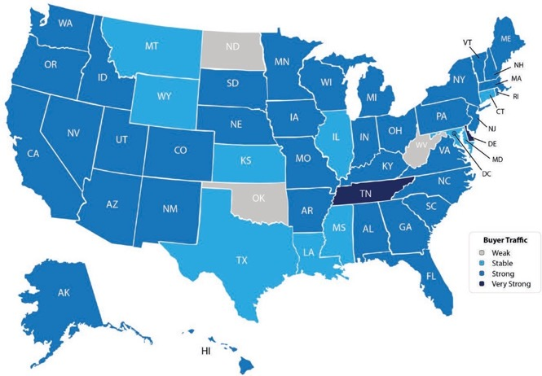
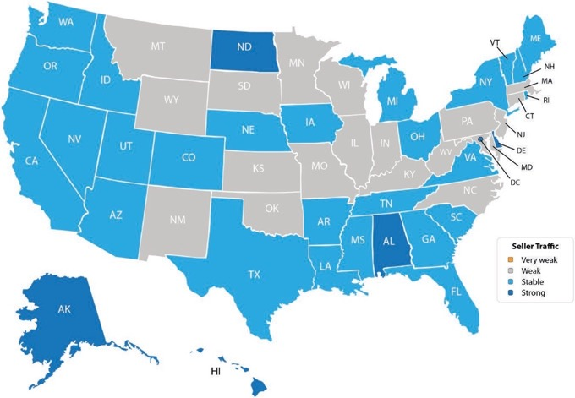
Buyer Demand Continues to Outpace Inventory of Homes For Sale
The price of any item is determined by the supply of that item, as well as the market demand. The National Association of Realtors (NAR) surveys “over 50,000 real estate practitioners about their expectations for home sales, prices and market conditions” for their Realtors Confidence Index.
Buyer Demand
The map on the right was created after asking the question:
“How would you rate buyer traffic in your area?”
The darker the blue, the more buyers are looking for homes in that area. Only 3 states came in with a weak demand level.
Seller Supply
The Index also asked:
“How would you rate seller traffic in your area?”
As you can see from the map on the left, a good portion of the country has weak seller traffic, meaning there are far fewer homes on the market than what is needed to satisfy the buyers who are out looking for their dream homes.
8

Slide 9
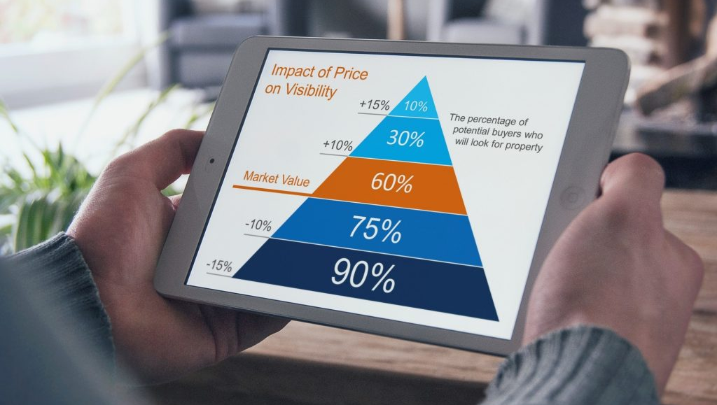
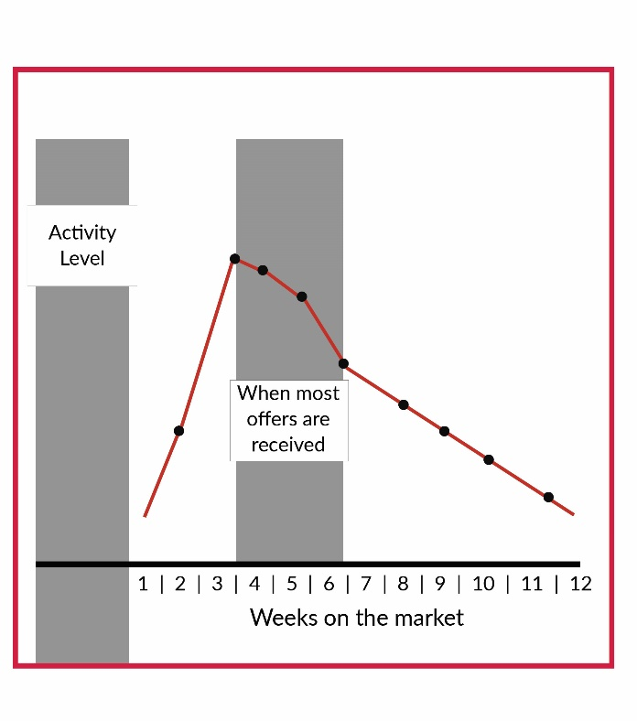
Price Competitively – The First 30 Days Are Critical
The Right Price Is Important
A property generates the most interest when it first hits the market.
The number of showings is greatest at this time, if it is priced at current market value.
Starting too high, and dropping the price later misses the excitement and fails to generate strong activity.
Many homes that start high end up selling below market value.

Slide 10
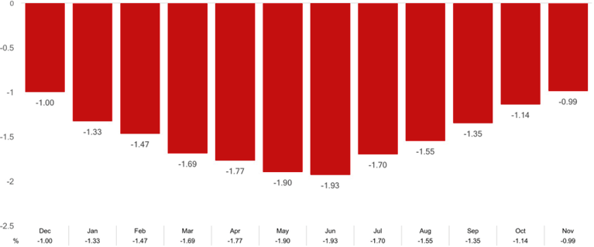
Remember: Your Home Must Be Sold Twice
In today’s housing market, where supply is very low and demand is very high, home values are increasing rapidly. Many experts are projecting that home values could appreciate by another 5%+ over the next twelve months. One major challenge in such a market is the bank appraisal.
If prices are surging, it is difficult for appraisers to find adequate, comparable sales (similar houses in the neighborhood that recently closed) to defend the selling price when performing the appraisal for the bank.
The chart below illustrates last year’s trend of appraisals vs contract sale prices.
Appraiser Home Value Opinions Compared to Homeowner Estimates
Every house on the market has to be sold twice; once to a prospective buyer and then to the bank (through the bank’s appraisal). With escalating prices, the second sale might be even more difficult than the first. Strategically pricing your home, will involve considering both what buyers are willing to pay and what banks are willing to finance.

Slide 11

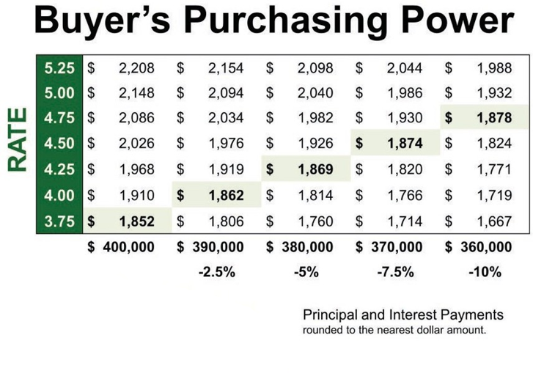
Move Up To The
Home You've Always Wanted
According to Freddie Mac’s Primary Mortgage Market Survey, interest rates for a 30-year fixed rate mortgage have hovered around 4% all year and are still near record lows.
The interest rate you secure when buying a home not only greatly impacts your monthly housing costs, but also impacts your purchasing power.
The chart to the right shows the impact rising interest rates would have if you planned to purchase a home within the national median price range, and planned to keep your principal and interest payments between
$1,850-$1,900
a month.
With each quarter of a percent increase in interest rate, the value of the home you can afford decreases by 2.5% (in this example,
$10,000).
Experts predict that mortgage rates will be closer to 5% by this time next year.
Act now while your dream home is still within reach!

Slide 12

