Slide 1


A GUIDE TO BUYING
YOUR HOME

Slide 2


There are a lot of websites designed to attract consumers that are searching for a home. Listing data is a way that businesses that are driven by the sale of new homes can capture new customers.
These websites have no motivation to ensure
their data is up to date!

Slide 3

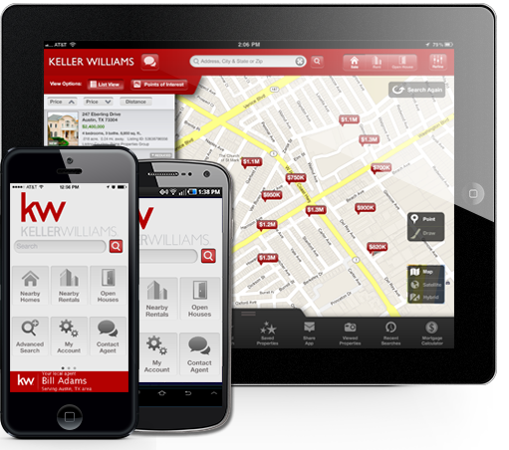
Keller Williams invests 2.3 million dollars per
month on our eEdge Business Solutions.
The Keller Williams award winning app is GPS-enabled and is connected directly to the Multiple Listing Service (MLS) allowing for properties to be searched and viewed with “real time” results.
Some other benefits include the ability to:
View property details and photos
Create notes for favorite properties
Easily “share” favorite properties with family and friends
Schedule showings directly from the app

Slide 4

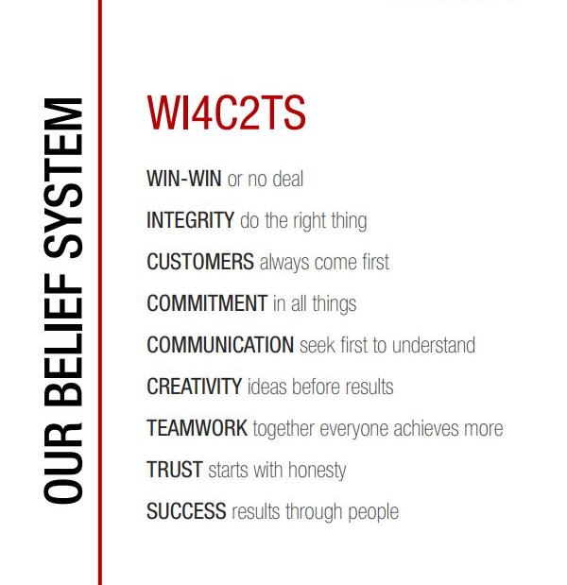

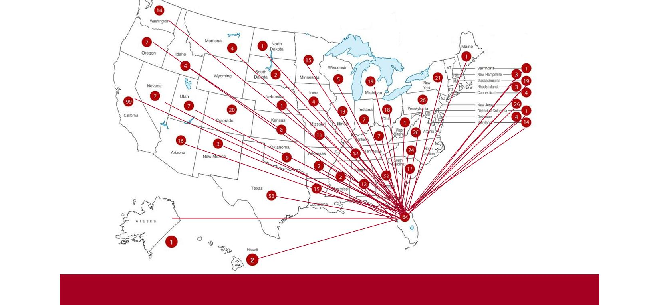
Keller Williams Agents are
Trusted – Recognized – Driven by Results

Slide 5
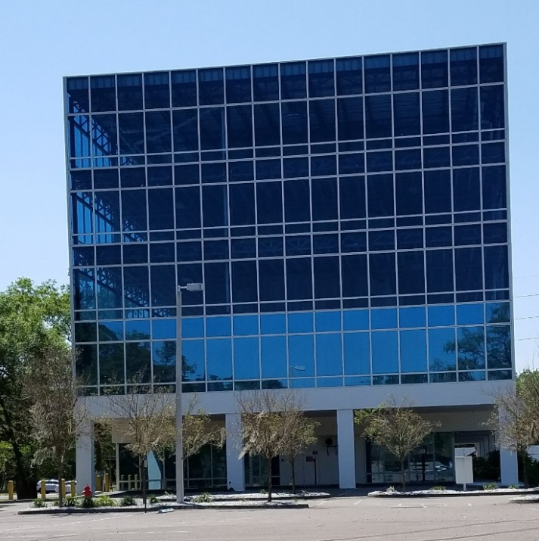

New location, new building, new opportunities for buyers and sellers.
As the largest most productive office in Hillsborough County, we dominate the market.
Our agents live, work and believe in our community. Our centralized location enables us to connect with the people we serve.

Slide 6
Why 89% of Buyers use a Realtor
Multiple Listing Service (MLS) Properties
As a member of the Multiple Listing Service, a Realtor® can show you any property, even from other real estate companies. Brokers that belong to the MLS have signed an agreement that they will offer compensation to other participating members.
If you should see a property on the internet, ad in the paper, or a sign in a yard, when you contact a Realtor® they will research the property and make an appointment to show it to you. Remember, the listing agent agreed to be an advocate for the SELLER when they signed the listing agreement.
For Sale by Owner
Many times a homeowner will work with an agent, even though the home is not listed with a real estate broker. In order for you to take advantage of all of the services offered by a Realtor® , it is necessary for them to introduce you to the property.
If you want to see a home offered by the owner and you want the advantages of a professional negotiator and other services, please do not contact an owner directly. Sellers marketing their home on their own often compensate Realtors® that represent buyers, they are simply trying to save on the marketing side of the commission.
New Construction
Most builders cultivate relationships with Realtors and are happy to work with agents who accompany the buyer to the property on the initial visit. If you visit new construction on your own, please remember to register your agent.
By working through a Realtor® with builders, you get all the services offered by your Realtor® in addition to those offered by the builder. You'll get more, but you won't pay more for it.
Each builder and their representatives are focused on selling the homes within their community. If you rely only on the information provided by the builder, you are missing out on the objective insights and expertise of having a personal advocate.
Short Sales and Foreclosures
Although these properties are less common than in previous years, these are the most intense real estate transactions in the market. Having a Realtor® is a tremendous advantage. These properties usually sell for under market value. However, they often lack typical disclosures and suffer from deferred maintenance. Extra inspections and time for due diligence should be included in your budget.

Slide 7
The home
BUYING process
1
2
3
4
REPRESENTATION
Interview agents, and select the best one for you.
PRE-APPROVAL
Confirm your purchasing power with a trusted lender.
BUYER CONSULTATION
Analyze your needs in a buyers consultation.
SELECT PROPERTIES
Select properties that you want to view
5
6
7
8
VIEW PROPERTIES
MAKE AN OFFER
Write an offer to purchase.
NEGOTIATE TERMS
Your Realtor is a resource for property, neighborhood and market analysis.
RATIFY THE CONTRACT
Once agreement is made and everyone signs, you have a contract.
9
10
11
REMOVE CONTINGENCIES
Conduct inspections, complete mortgage financing, obtain home owners insurance, and title insurance.
FUNDS FOR CLOSING
Confirm any email wiring instructions with a phone call to the title company.
CLOSING
The transfer of the property occurs at closing and you own a home!

Slide 8
When Buying A Home in Florida…
Property Taxes
In 1992 Florida voters modified the Florida constitution to cap the increase in a homesteaded property’s assessment to 3% or the annual increase in the Consumer Price Index, whichever is less. That amendment, known as Amendment 10 also provides for the homesteaded property’s market value becoming its assessed value upon the property’s deed transfer. A change of ownership triggers reassessment of the property to market value.
Because of Amendment 10, some home purchasers are liable for substantially higher property taxes than the previous owner of the home.
Homeowners Insurance and Flood Insurance
Any property that has a mortgage is required to obtain insurance. (It is also wise for homeowners who pay cash for a home.) Florida has several increased risks for insurance companies which include: hurricanes, sink holes, and flooding. It may be necessary to allot more of your housing budget toward insurance than in other states, so it is important to include this figure in your monthly payment calculations.
Community Development District or CDD
These are special taxing districts (usually large master planned communities) that impose special taxes and assessments to pay for the construction, operation, and maintenance costs of certain public facilities of the district. These taxes and assessments are in addition to county and all other taxes and assessments provided by law. These fees are paid in advance, so you will reimburse the seller a per diem rate at closing based on the closing date.
Deed Restrictions
Certain neighborhoods and communities have deed restrictions that may affect your use of the property. (These restrictions often include size and type of pet, RV and boat storage, and modifications to homes in the neighborhood) If the property is affected by deed restrictions, you should consult with an attorney to determine the nature of the restrictions and how they will impact your use of the property prior to entering into a contract.
School Districts
Schools are administered by the county; therefore, school boundaries are subject to change. If this information is important to you, contact the local school board directly to verify the correct school boundaries for the particular property prior to entering a contract. There is no guarantee of continued assignment under the current system.

Slide 9
Closing 101
Prepare for It
Closing day marks the end of your home-buying process and the beginning of your new life! To make sure your closing goes smoothly, you should bring the following:
• Arrange for a wire transfer of funds to the title company
* Please confirm all wire transfers with a call to your Realtor or title company as there have been email scams that direct funds to unauthorized accounts
• An insurance binder and paid receipt
• Photo IDs
• Social security numbers
• Addresses for the past 10 years
Own It
Transfer of title moves ownership of the property from the seller to you. The two events that make this happen are:
  Delivery of the buyers funds
  This is the check or wire funds provided by your lender in the amount of the loan. Keys will not be turned over without cleared funds.
  Delivery of the deed
  A deed is the document that transfers ownership of real estate. The deed names the seller and buyer, gives a legal description of the property, and contains the notarized signatures of the seller and witnesses.
At the end of closing, the deed will be taken and recorded at the county clerk’s office. It will be sent to you after processing.

Slide 10
“Top 10” Things To Avoid Before Closing
Do not change jobs,
become self-employed or quit your job.
Do not buy a car, truck or van
(or you may be living in it)!
Do not use charge cards excessively
or let your accounts fall behind.
Do not spend money
you have set aside for closing.
Do not omit debts or
liabilities from your loan application.
Do not buy furniture.
Do not originate any
inquiries into your credit.
Do not make large deposits
without checking with your loan officer.
Do not change bank accounts.
Do not co-sign a loan for anyone.

Slide 11


Living, Working and Believing in the communities we serve
Our Keller Williams – Chadwick Group has multiple locations throughout Tampa Bay with over 900 agents networking to accomplish the goals of buyers and sellers.

Slide 12



